Slide 1
The Standardization
Survival Kit & EHRI-EAD
For a wider use of archival standards within Arts and Humanities
Charles Riondet (Inria Paris)

Slide 2
Outline
Innovative way of managing heterogeneity of EAD;
Documented and reusable, via the Standardization survival kit (SSK);
Open platform for hosting resources related to metadata standards, curated in research scenarios.
Notes:
The goal of my presentation is twofold:
First, show an innovative way of managing heterogeneous archival descriptions, developed in the context of the EHRI project
Second, explain the even broader context in which this solution is sustained and documented : the Standardization Survival Kit, a platform where one can find or create information materials describing scenarios where standards play a key role in Humanities research.

Slide 3
Notes:
The work I'm presenting here has been carried out for the EHRI project, known by most of you I guess, and more specifically its main product, the EHRI portal, giving access to 19,071 archival descriptions related to the Holocaust.

Slide 4
http://www.parthenos-project.eu/
Notes:
But work also supported by another european project, maybe less know : PARTHENOS, which aims at harmonizing, when possible, the practices and policies of researchers in different Humanities disciplines, by giving access an integrated access to research services and tools.
One of these service is the Standardization Survival Kit.

Slide 5
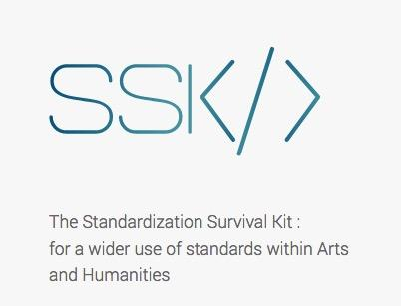
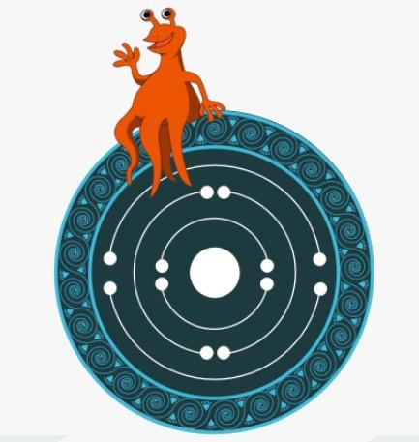
The Standardization Survival Kit: a toolkit for Humanities scholars
Documenting
Supporting
Training
Communicating
https://ssk.parthenos-project.eu/ssk/
Notes:
The work carried out by the SSK covers four types of activities related to the deployment and use of standards in the Humanities and Cultural Heritage fields:
Documenting existing standards => provide reference material
Supporting the actual adoption of standards by showing how they relate to research scenarios
Communicating with research communities about
the need to apply standards in their digital scholarly practices
but also be informed of the essential standards for their own fields.
Training for researchers, by giving them access to complete frameworks so that they acquire knowledge and know-how on standardized methodologies.

Slide 6
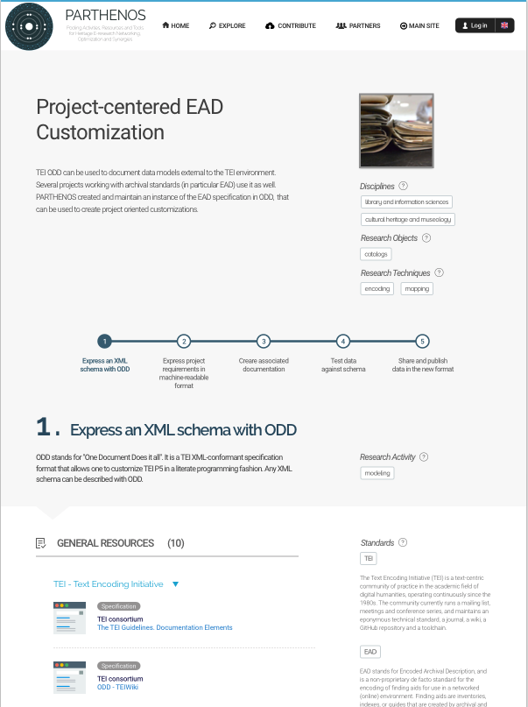
The scenarios
Place your screenshot here
Providing contextual information and relevant examples on how standards can be applied in a given research project.
Notes:
The SSK focuses on giving researchers access to standards in a meaningful way. That is why it is built around research scenarios.
Contextual information and relevant examples to use standards in a concrete way.
The scenarios cover all the domains of the Humanities, from Literature to Heritage science, including History, Social sciences, Linguistics, etc. and have been created by domain experts
They can be seen as a living memory of what should be the best research practices in a given community, made accessible and reusable for other researchers wishing to carry out a similar project but unfamiliar with the recommended tools, formats, methods to use, etc.

Slide 7
Three layers
Us
Scenario
Step
Resource
A complete and generic research use case composed of several steps to be followed.
A unique task to be performed inside a scenario with the help and recommendation of one or several resources.
A standardized tool / service / document guiding the researcher in her/his tasks completion.
Notes:
The SSK is structured in 3 layers =
scenarios
steps
resources
A scenario represents a research process.
A step is a task to perform, using the resources and recommendations that are linked to it.
The resources are documentation, links to tools and services, etc, useful for the task.

Slide 8
The TEI model
The scenarios are described using the TEI format (Text Encoding Initiative). All the information displayed within the SSK proceed from TEI files.
A scenario is a list of events (<tei:listEvent>), each step in a scenario is an event (<tei:event>).
TEI files are all available on Github (https://github.com/ParthenosWP4/SSK).
Notes:
A quick word on the specifications of the SSK :
-> All these layers are described with TEI ( Text Encoding Initiative).
A scenario is a list of events (<tei:listEvent>), each step in a scenario is an event (<tei:event>).

Slide 9
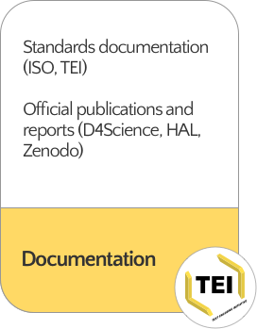
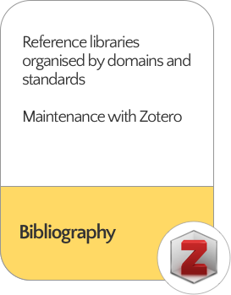
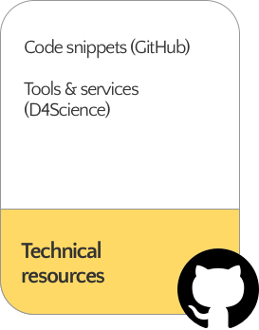
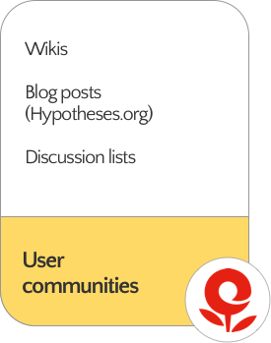
Handling the resources
Notes:
The resources are of several types
Official documentation of standards
Papers, webpages, …, maintained in a Zotero Library
Technical resources => GitHub and similar repositories
User communities content => mainly academic blogging, wikis, ...

Slide 10
Project-centered EAD customization
Place your screenshot here
A SSK scenario, derived from the EHRI use case
with a focus on the role and the value of community standards, like EAD and TEI in data integration, enrichment, sharing lifecycles.
Notes:
One of the scenarios that can be found in the SSK is derived from the EHRI use-case I will now present.
It presents the methodology and the resources used to create a project-centered EAD customization.

Slide 11
EHRI context and challenges
Dispersed sources
1900 institutions with different:
Histories of custody,
Cataloguing practices,
Digitization level
A federated portal
Notes:
The EHRI portal is a perfect environment to implement this idea.
_ Because of the natural and obvious heterogeneity of the corpus (diversity of languages, description level, practices)
_ And the final goal to ingest them in a single environment

Slide 12
EHRI & EAD
Pivot format: EAD2002 + EHRI specific description rules
When possible, automatic mapping from:
EAD1, Dublin Core, home made formats
EAD 2002 with very different encoding guidelines
How to preserve content and meaning when exchanging/reusing archival content?
Notes:
EHRI's pivot format is EAD 2002, with specific description rules
Automatic mappings to this format are available via a conversion tool. This tool uses a validation schema
A pending question, related to EAD permissive nature is how to preserve content and meaning when exchanging/reusing archival content?

Slide 13
Proposal:
EAD customizations
Narrowing EAD countless possibilities
Quality checks and content-oriented rules
Without modifying the schema
Notes:
What we propose is a system that narrows EAD permissiveness + allows for quality checks and content-oriented rules
Without modifying the original EAD 2002 schema.

Slide 14
How?
TEI long lasting experience -> One document does it all (ODD):
Schema fragments, prose documentation and reference documentation in a single document
ODD allows for total flexibility to model specific subsets or extensions of the described format.
Straightforward way to customize any XML format according to specific practices and document this customization
Notes:
We are inspired by another very strong community format : the Text Encoding initiative. What we are interested in is a subset of the TEI meant to create XML format specification (the TEI itself is described with this subset of TEI).
This is called “One document does it all” and it is a very powerful system, with which it is possible to model specific subsets, extensions or profiles of the described format.
In other words, it allows us easily to refine the behaviour of elements and attributes, for any XML format, can contain all the human readable documentation and can be processed to generate various resources : a validation schema (many formats) and associated documentation (many formats).

Slide 15
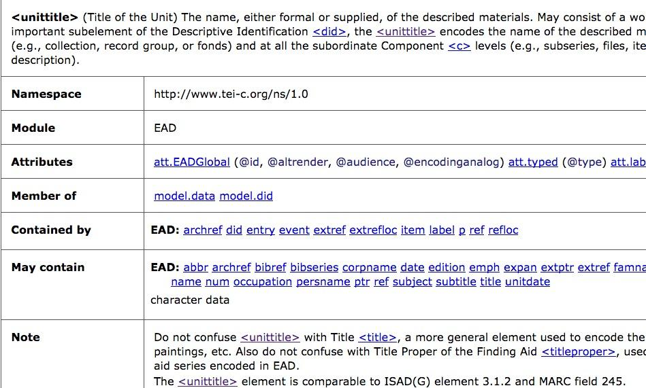
Defining an XML element with ODD
<elementSpec ident="unittitle" module="EAD">
<gloss>Title of the Unit</gloss>
<desc>The name, either formal or supplied,
of the described materials. ...</desc>
<classes>
<memberOf key="att.EADGlobal"/>
…
</classes>
<content>
<rng:zeroOrMore>
<rng:choice>
<rng:text/>
<rng:ref name="unitdate"/>
<rng:ref name="date"/>
…
</content>
<exemplum>
…
</exemplum>
<remarks>
<p>Do not confuse <gi>unittitle</gi>
with Title <gi>title</gi>, ... </p>
documentation
schema
<define name="unittitle">
<element name="unittitle">
<a:documentation>(Title of the Unit) The name, either formal or supplied ...</a:documentation>
<zeroOrMore>
<choice>
<text/>
<ref name="unitdate"/>
Notes:
Example=
Gloss, desc => documentation
Classes => to link elements with their attributes
Content => relaxNG specification, what elements can be children of the described element

Slide 16
ODD and EAD ...
An ODD file that covers EAD entirely:
The official schema: www.loc.gov/ead/ead.rng
The Tag Library: http://loc.gov/ead
Maintained by Parthenos (possibility to contribute and reuse) http://github.com/ParthenosWP4/standardsLibrary/blob/master/archivalDescription/EAD/ODD/EADSpec.xml
Notes:
The official EAD schema and the official EAD tag library are encoded in a ODD document (Agreement of the Library of Congress and the Society of American Archivists)
In Parthenos environment à Github, anyone can use the resources and propose enhancements

Slide 17
… and EHRI
Very precise content oriented rules based both on EHRI and CHI input data models
Integrating the human readable documentation in the validation process → deepen the relationship between validation and documentation
Notes:
The EAD ODD is a starting point for EHRI, used to create an EHRI-specific EAD profile with very precise content oriented rules based on EHRI requirements and on the CHI data models.

Slide 18
Flexible and customizable methodology
Use ODD to create specific EAD profiles
Each new EAD profile => new ODD
Inheritance to the master source + possibility to modify the elements that have a different behaviour
Don’t change the core EAD schema, but add more specific rules
EAD schema (expressed in RelaxNG)
ISO Schematron rules
Notes:
So, EHRI has its own ODD, project specific, where we modify the elements and attributes that have a different behaviour.
The Philosophy here is to keep the EAD schema as it is, so we don’t modify nirectly with RelaxNG specifications, but we use another validation language : Schematron, that can be very precise and add rules to very particular elements.

Slide 19
Flexible and customizable methodology
EAD Schema
(RelaxNG, XML schema, DTD)
EAD ODD
generates
EAD Tag library
(HTML, PDF, eBook, …)
inherits
EHRI EAD Schema
(RelaxNG+ schematron)
EHRI EAD ODD
generates
EHRI EAD
Tag Library

Slide 20
Creating EHRI EAD specification
<schemaSpec ident="EHRI_EAD" start="ead" ns="urn:isbn:1-931666_22_9"
source="https://raw.githubusercontent.com/ParthenosWP4/standardsLibrary/master/archivalDescription/EAD/odd/EADSpec.xml">
…
<elementSpec ident="altformavail" module="EAD" mode="change">
<constraintSpec ident="copyLinking" scheme="isoschematron" type="EHRI" mode="add">
<desc>If the element <gi>altformavail</gi> is not empty, you COULD try to identify if
the originals are present in the EHRI portal and make a link between the two
descriptions.</desc>
<constraint>
<rule xmlns="http://purl.oclc.org/dsdl/schematron" context="ead:altformavail"
see="&path;#EAD.altformavail">
<assert xmlns="http://purl.oclc.org/dsdl/schematron" role="COULD"
test="not(normalize-space(.))"> If the element altformavail is not empty, you
COULD try to identify if the originals are present in the EHRI portal and make a
link between the two descriptions</assert>
</rule>
</constraint>
</constraintSpec>
</elementSpec>
Modify element
Original
EAD-ODD
Add a
constraint
Schematron rule + message

Slide 21
Schematron rules
Emphasize EAD validation errors
Content normalisation (dates, codes, …)
Align the descriptions with EHRI constraints
e.g. require at least one <scopecontent> element
Highlight some description elements that could be improved
Not errors, but pieces of advice.
In particular for content related elements (existence of copies of the material, bibliographical references, …)

Slide 22
Connect to ad hoc documentation
A full description of the expected content (i.e. HTML “tag library”) is generated from the ODD file.
In the validation process, the documentation is served to the user in context
EAD technical documentation
EHRI technical documentation
EHRI qualitative documentation

Slide 23
EHRI validation Workflow
(Re)process
Input data in EAD
(native or converted)
EAD validation
EAD doc
EHRI-EAD schema
EHRI validation
schematron
EHRI doc
Validation results
Re(process)
+ Comprehensive messages and guidelines

Slide 24
Reusable by nature
Browse the SSK scenario
https://ssk-application.parthenos.d4science.org/ssk/#/scenarios/AWIAi0mRe-S72mFoMfe-/1 (beta)
Read the paper
Laurent Romary, Charles Riondet, EAD-ODD: A solution for project-specific EAD schemes, Archival Science, 2018, https://hal.inria.fr/hal-01737568,

