Slide 1
Trust & Understanding
Building Bridges: Mapping the XML
Standard for the Social Sciences
“Data Documentation Initiative”
(DDI) to EAD
Benjamin Peuch
DARIAH-EU Workshop
Brussels, State Archives of Belgium
14 May 2018

Slide 2
The SODA project
“Social Sciences Data Archive”
A (scientific) data archive
For the social sciences
To archive research data
To allow for its re-use
To integrate CESSDA – Consortium of European social science data archives

Slide 3
The SODA project
Legal & organizational aspects
Legal form
Business model
Cost model
Contracts and licenses
Access and use conditions
GDPR + DPO + "Digital Act"
Technical aspects
System architecture
Software programs
Workflows
Metadata standard(s)
Training and user guides
Retrospective conversion

Slide 4
The SODA project
Hypothesis: The future Belgian data archive for social sciences becomes part of the State Archives
Corollary: Part of the existing infrastructure at the State Archives will be re-used for the needs of the data archive
Consequence: We need crosswalks at the level of metadata to allow for (partial) automated transfers

Slide 5
Social science data & metadata
Social science data: datasets
Quantitative and qualitative data
The metadata standard for social sciences: Data Documentation Initiative (DDI)

Slide 6
Social science data & metadata
DDI-Codebook for deciphering the variable names (codes) generated by statistical software (SPSS, SAS, R…)
DDI-Lifecycle for recording the entire lifecycle of the data
DDI 4…

Slide 7
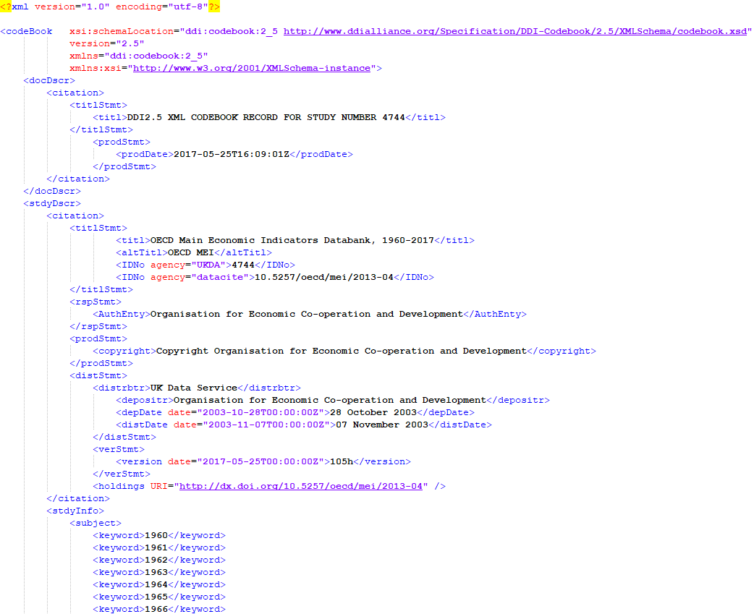

Slide 8
Building bridges A crosswalk towards EAD
It would be advantageous to transfer some of the information contained in DDI, in an automated or semi-automated manner, towards EAD…
… so that we can already use this information with the existing data and metadata processing infrastructure at the State Archives

Slide 9
What I should have done (1)
Examine the various metadata standards already in use at the State Archives (not just EAD: EAC, EAG, METS…) and understand how they function together
Classify the DDI-Codebook fields by types of metadata (descriptive, administrative, technical, structural and preservation)

Slide 10
What I should have done (2)
See which of these metadata types must transfer from DDI to EAD — and which do not
Map the specifically identified tags that are likely to contain the information we seek to transfer from DDI to EAD

Slide 11
What I did
Map ALL the tags!

Slide 12
Interesting aspects ’Identifier overload’
Assume you want to retrieve identifiers
Where do you reallocate them?
<unitid>?
<… ID>?
"The previous identifier for this element was…"

Slide 13
Interesting aspects Authors and contributors
DDI <producer>
<verResp>
<distrbtr>
<depositr>
<contact>
<AuthEnty>
<notes resp>
EAD <author>

Slide 14
Next steps
Calibrating the mapping
Deciding what roles of DDI EAD will take on
Investigating how EAD can supplement DDI
Determining the roles of traditional historians in the future data archive

Slide 15
Thank you
for your attention!
Any question?

